Slide 1
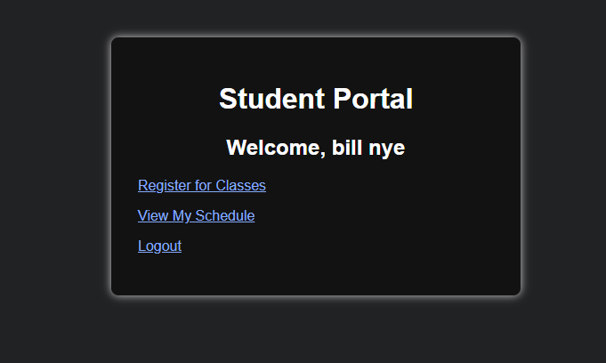
Online Course
Registration System
Final Software Project Presentation
Justin Lopez
CST499: Capstone for Computer Software Technology
Instructor: Dr. Butler
September 8th, 2026
Student Portal — successful login
Requirements → UML Design → PHP / MySQL Implementation
Final project artifacts are based on the Week 1–4 course assignments and screenshots.
Notes:
Hello, my name is Justin Lopez. This presentation summarizes my CST499 final software project, an Online Course Registration System. The project moved from requirements definition, to UML design, and then into a working PHP and MySQL prototype. I will review the Software Requirements Specification, the UML models, the landing, login, and registration pages, the relational database and class-registration features, and the PHP logic that connects the front end to the database.

Slide 2
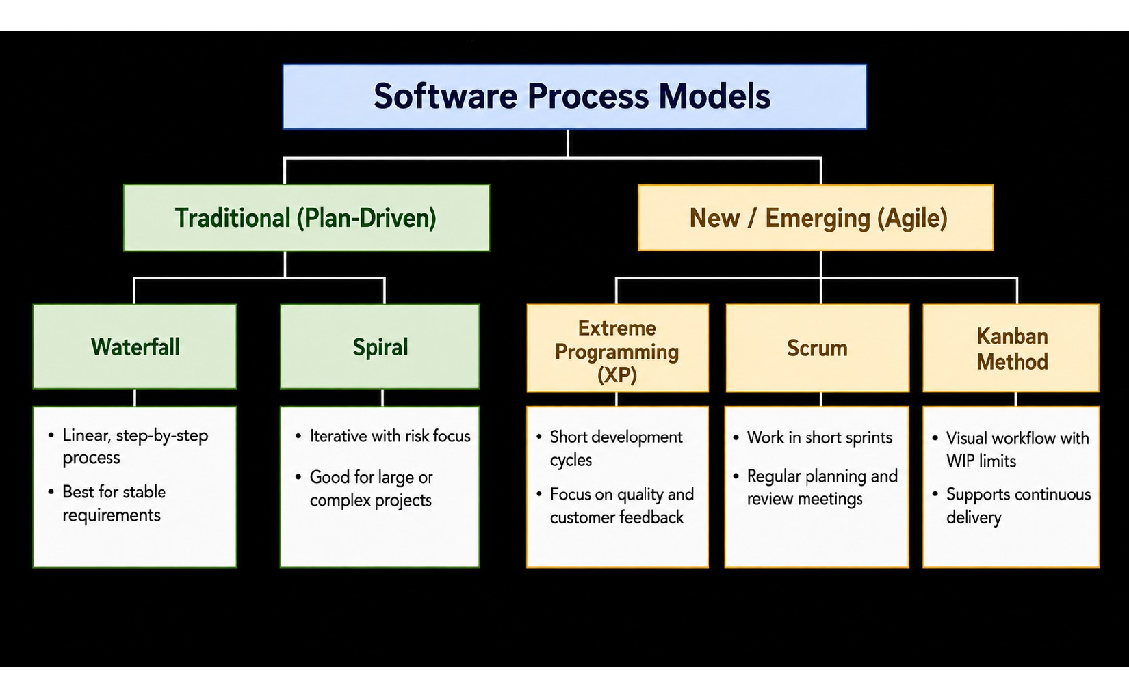
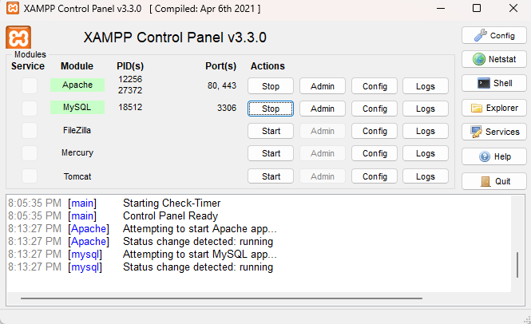
Project Development Roadmap
The course project progressed from process planning to requirements, design, implementation, and verification.
Week 3 — XAMPP environment
Week 1: defined the SRS and major student-facing requirements.
Week 2: translated the requirements into five UML design models.
Week 3: built the XAMPP, PHP, MySQL, landing, login, and registration foundation.
Week 4: added course registration, enrollment records, and schedule management.
Week 1 concept map — software process models
Sources: Week 1 concept map; Week 3 Assignment Figure 1.
Notes:
The project followed the same progression that was explored earlier in the course through the software process model concept map. The concept map compares traditional and Agile approaches, while the actual capstone work was completed incrementally across the weeks. Week 1 established the system requirements. Week 2 turned those requirements into UML models. Week 3 created the local XAMPP environment and the initial PHP pages. Week 4 extended the prototype with relational tables and schedule-management features. This progression made each new piece build on work that had already been completed and tested.

Slide 3
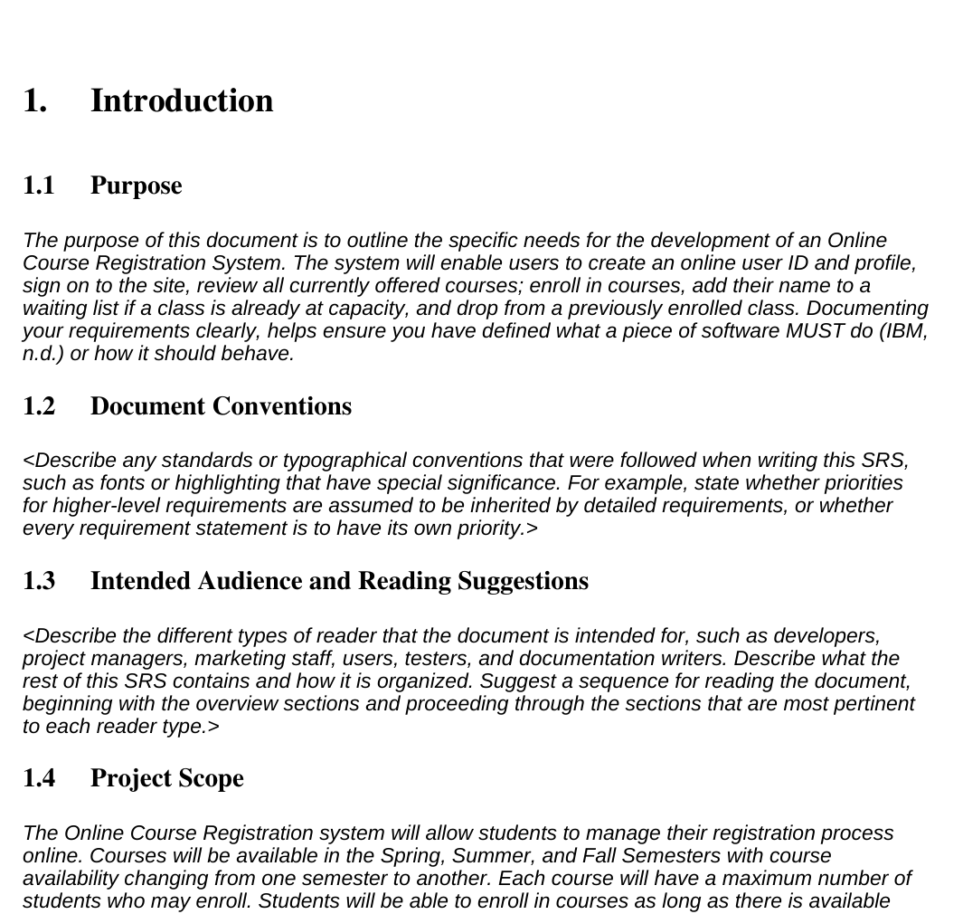
SRS: Purpose and Project Scope
The SRS established what the system should do before implementation began.
Core SRS scope
Create a student account and profile with unique credentials.
Log in and restrict access when credentials are invalid.
View course offerings by semester.
Enroll when space is available and enforce capacity limits.
Support a waiting list, cancellation, and seat-availability notification.
Primary user: Student
SRS purpose and project scope — Week 1
(Tsui et al., 2018)
Notes:
The Software Requirements Specification was the baseline for the rest of the project. Its purpose was to define the specific needs of the Online Course Registration System before design and coding began. The primary user is a student. The SRS requires account creation, secure login, semester-based course viewing, enrollment with capacity limits, waiting-list behavior, cancellation, and notification when a seat becomes available. These requirements gave the UML models and later PHP implementation a clear target. The later prototype concentrated on the core account, registration, and schedule-management functions, while the SRS preserved the broader waitlist and notification requirements for future expansion.

Slide 4
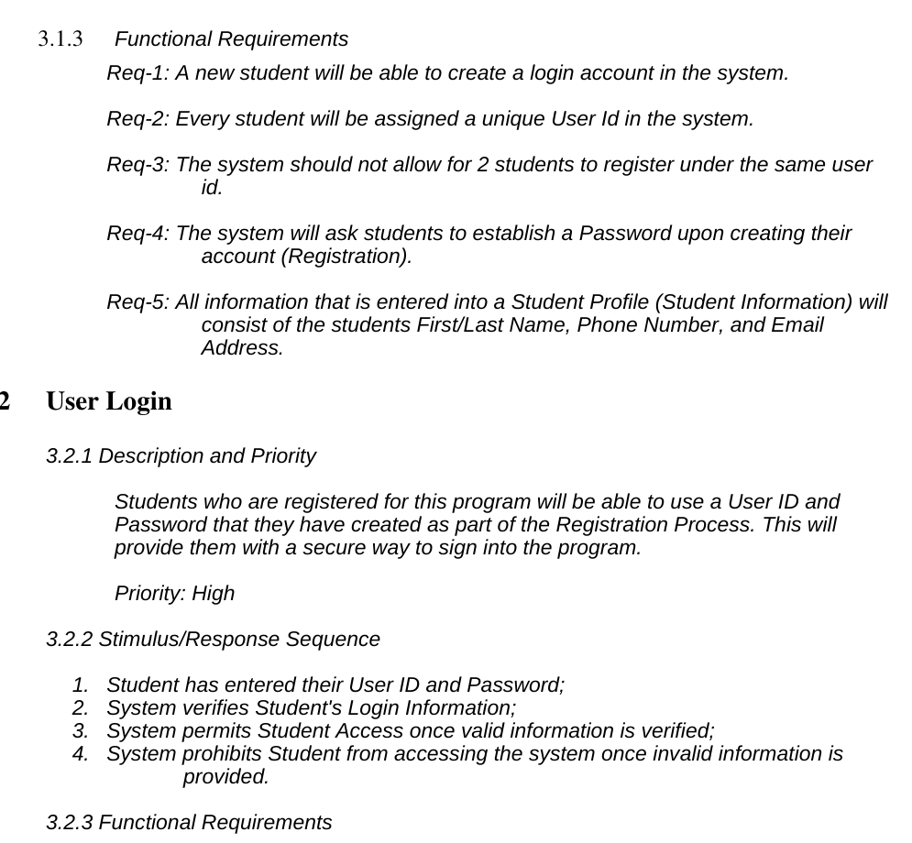
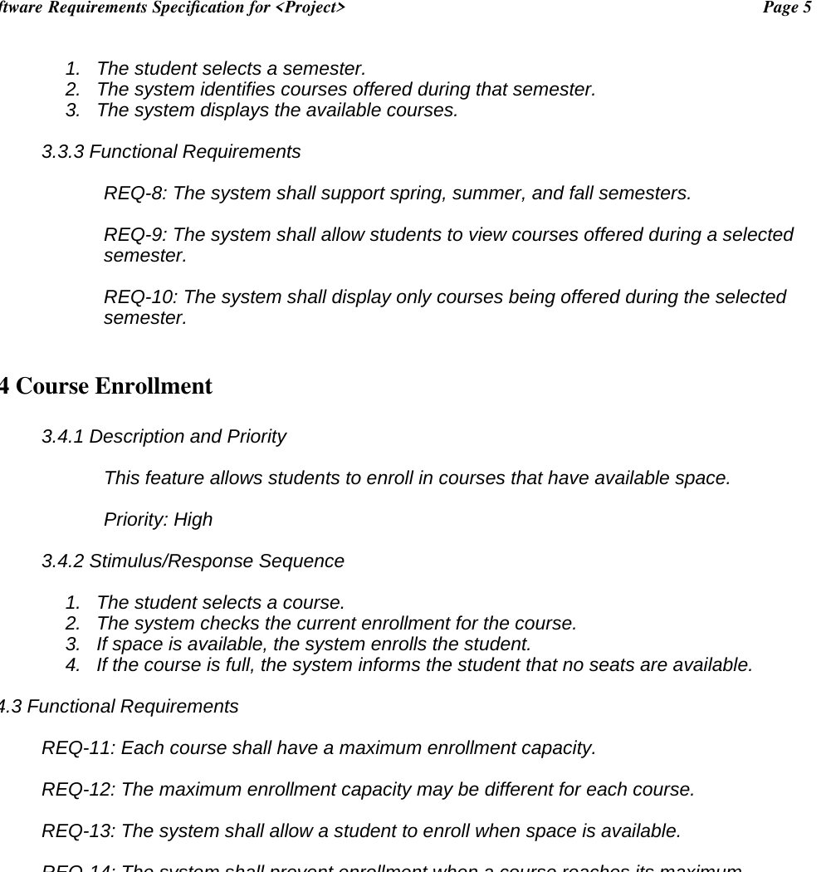
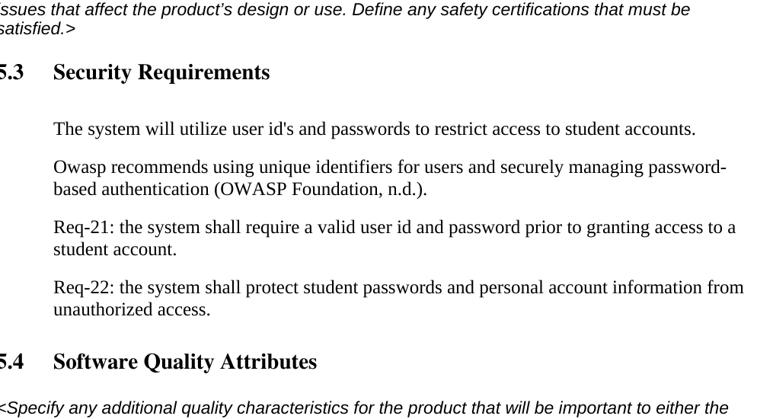
SRS: Functional and Security Requirements
The requirements were broken into traceable groups for registration, enrollment, and access control.
REQ-1–7 • registration and login
REQ-8–14 • semesters and enrollment
REQ-21–22 • security
The SRS ultimately defined 22 requirements, including unique user IDs, valid credential checks, course-capacity rules, waitlists, cancellation, notification, and protection of account information.
Notes:
The functional requirements were organized so each major behavior could later be traced into design and testing. Requirements one through seven cover account creation, unique usernames, password creation, and login validation. Requirements eight through fourteen cover semester course listings and enrollment capacity. The next group covers the waiting list and cancellation workflow. Finally, requirements twenty-one and twenty-two require valid credentials before account access and protection of student passwords and personal information. This traceability is important because it lets the design and implementation be compared back to specific requirements rather than relying on a general idea of what the portal should do.

Slide 5
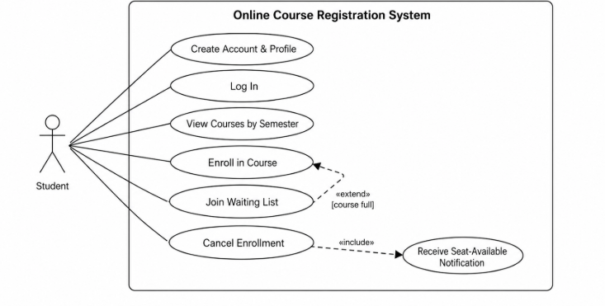
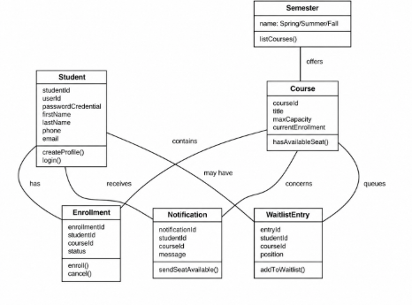
UML Design Model: Static View
Use case and class diagrams translate the SRS into actors, functions, and data relationships.
Use Case Diagram — Week 2
Class Diagram — Week 2
Student actor → account, login, course viewing, enrollment, waitlist, cancellation, notification
Core classes → Student, Semester, Course, Enrollment, WaitlistEntry, Notification
(Ahmad et al., 2019; Tsui et al., 2018)
Notes:
The static UML view is represented by the use case and class diagrams. The use case diagram identifies the student as the main actor and shows the actions defined by the SRS, including account creation, login, viewing courses, enrollment, joining a waitlist, canceling enrollment, and receiving a seat-availability notification. The class diagram identifies the major information objects needed to support those behaviors: Student, Semester, Course, Enrollment, WaitlistEntry, and Notification. It also shows how those objects relate to each other. UML was useful here because it provided a visual bridge between written requirements and the structure that would eventually be represented in code and database tables.

Slide 6
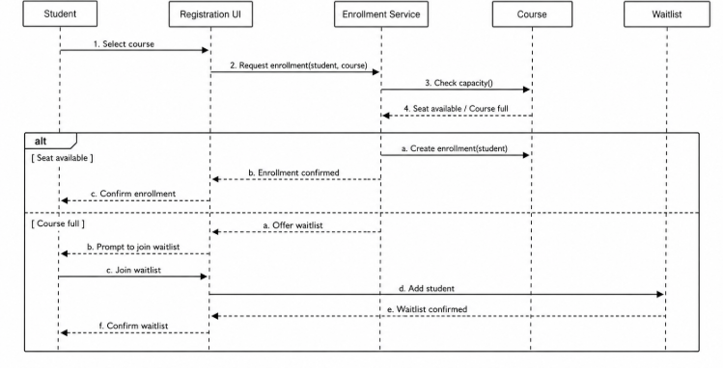
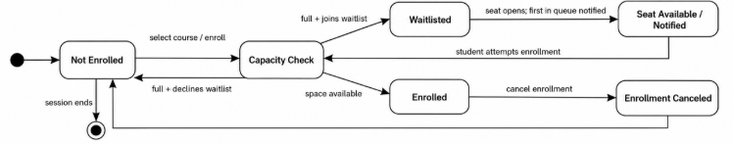
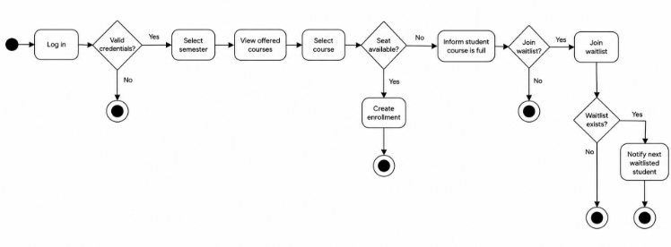
UML Design Model: Behavioral View
Sequence, activity, and state diagrams show how registration behavior changes over time.
State — student/course registration
Sequence — course enrollment and waitlist
Behavior captured
Capacity check determines enrollment or waitlist path.
Workflow links login, course selection, enrollment, waitlist, and cancellation.
State changes track Not Enrolled → Enrolled / Waitlisted → Canceled or Notified.
Activity — registration workflow
(Ahmad et al., 2019)
Notes:
The behavioral diagrams describe what happens as a student moves through the system. The sequence diagram follows a course request from the student interface to the enrollment service, then checks course capacity and branches to either enrollment or a waitlist option. The activity diagram provides a broader workflow from login through course selection, enrollment, waitlisting, and notification. The state diagram focuses on the student's status for one course, such as not enrolled, undergoing a capacity check, enrolled, waitlisted, notified, or canceled. Together, these models helped make the SRS behavior more concrete and also created paths that could later be used for testing.

Slide 7
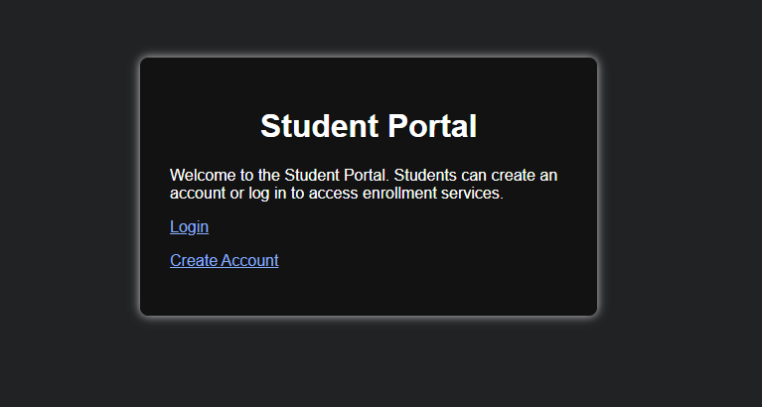
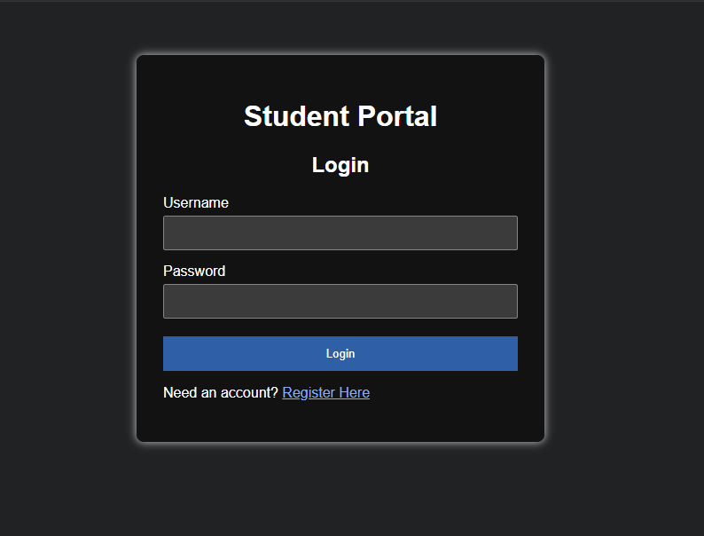
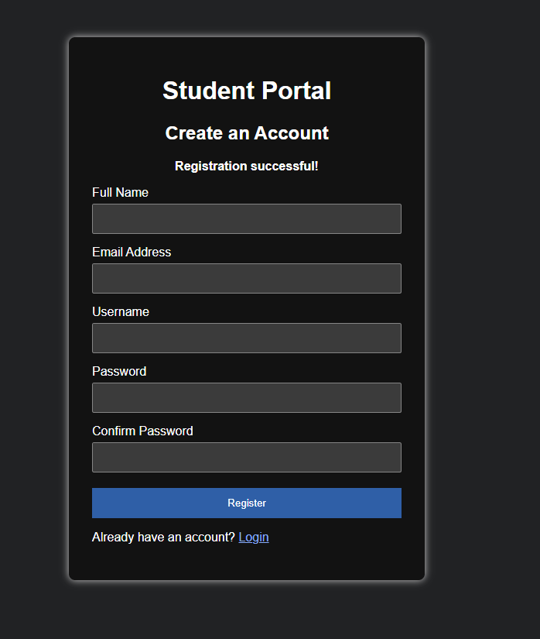
Landing, Login, and Registration Pages
The interface was intentionally simple so students could immediately understand the next action.
Landing page
Login page
Registration page
Start / navigation
Username + password authentication
Name, email, username, password + confirmation
Source: Week 3 Assignment, Figures 2–3 and registration-page screenshot.
Notes:
The Week 3 implementation created the user-facing foundation of the portal. The landing page is a simple starting point with links to login or create an account. The login page asks for a username and password and later became the entry point for authenticated access. The registration page collects the information required to create a new account, including full name, email, username, password, and password confirmation. HTML defines the form structure and CSS provides a consistent dark visual design. The registration form submits information with the POST method so PHP can validate the input and send approved data to MySQL.

Slide 8
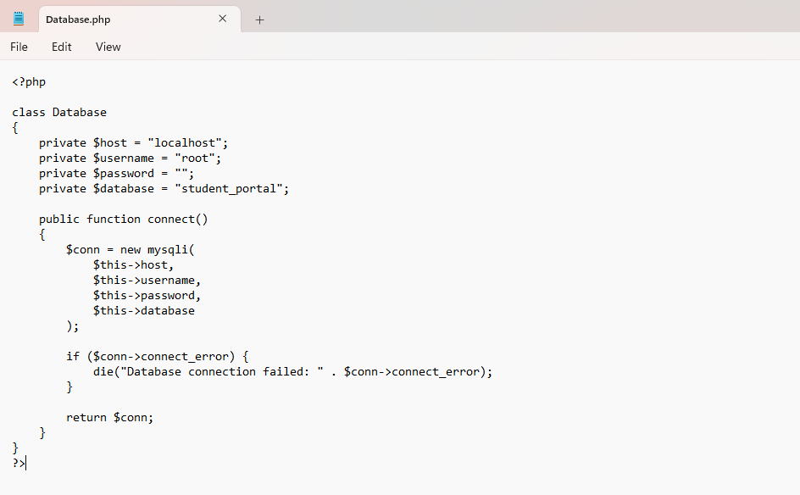
Database Connection and Registration Logic
A reusable Database.php class and prepared SQL statements support secure account creation.
Registration form
Database.php centralizes host, user, password, and database settings.
Registration validates required fields and matching passwords.
password_hash() stores a one-way password hash.
Prepared statements separate SQL from user-supplied values.
Database.php — custom MySQLi connection class
(Halfond et al., 2006)
Notes:
The database connection was separated into a custom Database.php class. That class stores the host, username, password, and database name, then exposes a connect method that returns a MySQLi connection. This avoided repeating connection settings on every PHP page. On the registration side, PHP checks that required fields are present, validates the email address, compares the two password fields, and checks for an existing email or username. Before insertion, the password is converted to a one-way hash with password_hash. Prepared statements are used so the values are bound separately from the SQL command, which is an important protection against SQL injection attacks, as discussed by Halfond and colleagues.

Slide 9
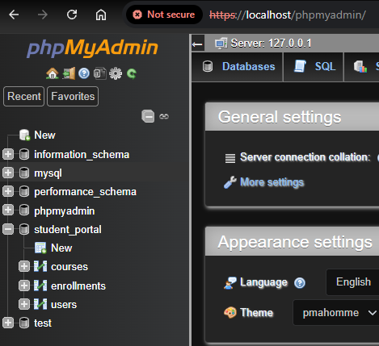
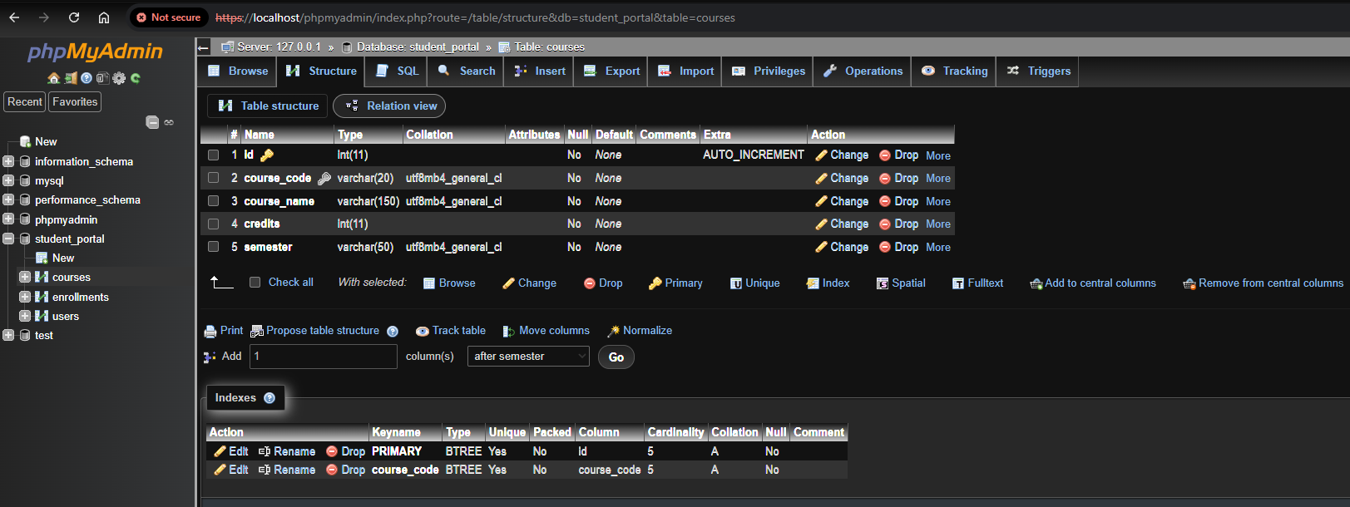
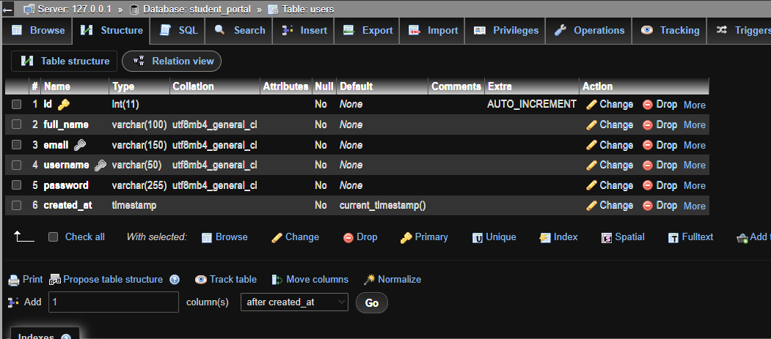
MySQL Relational Database Design
The student_portal database separates users, courses, and enrollment relationships.
courses table and test course records
users ↔ enrollments ↔ courses
phpMyAdmin — student_portal tables
users table structure / stored registration record
Primary keys identify records. Foreign keys in enrollments connect students to courses. A unique user/course combination prevents duplicate enrollment.
(Codd, 1970)
Notes:
The database was expanded into a relational structure with three main tables. The users table stores account information. The courses table stores course code, course name, credit hours, and semester. The enrollments table acts as the bridge between users and courses. Its user_id and course_id fields are foreign keys that point back to the primary keys in the other two tables. This creates a many-to-many relationship: one student can take multiple courses, and one course can have multiple students. A unique combination of user and course also prevents the same student from registering for the same class twice. This design follows the relational principles introduced by Codd.

Slide 10
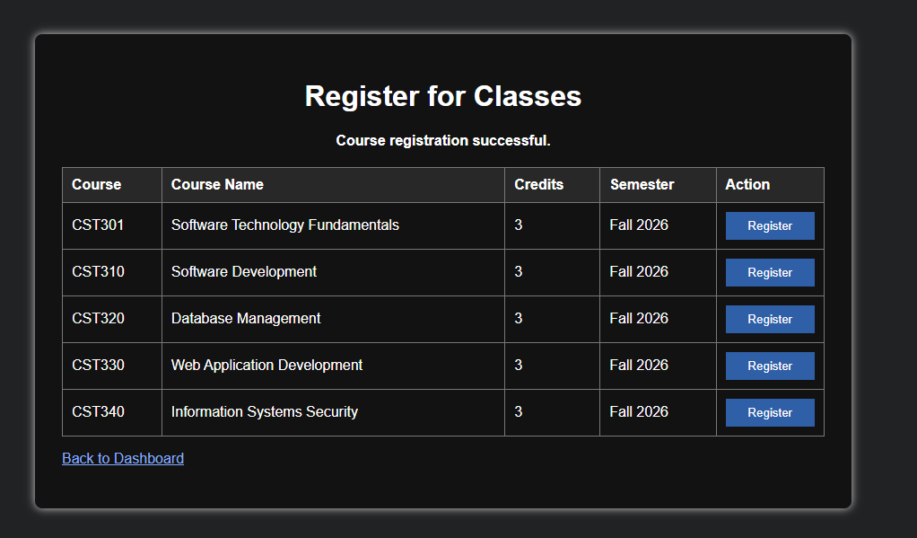
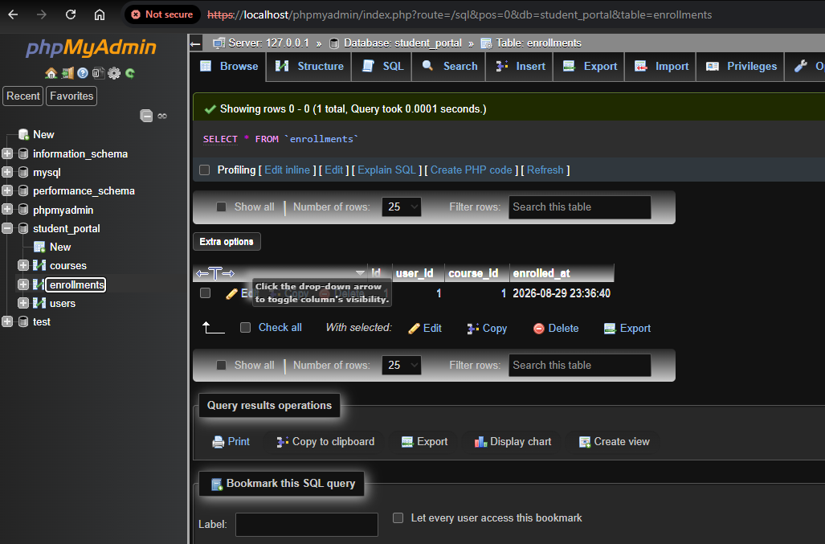
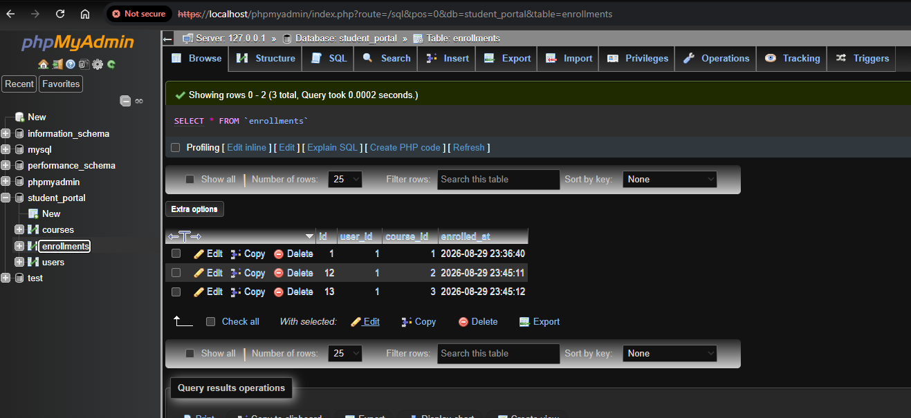
Class Registration and Enrollment Records
The registration page reads available courses and writes the student-course relationship to MySQL.
enrollments table after first course
Successful course registration — Week 4
additional enrollment records
SELECT courses → POST course_id → INSERT enrollment
Source: Week 4 Assignment screenshots — successful registration and database before/after evidence.
Notes:
The class-registration workflow uses the courses table as the source of available classes. The register_classes.php page runs a SELECT query and formats those records into an HTML table with a Register button for each course. When a student selects a course, the course ID is submitted by POST. PHP combines that value with the authenticated student's session ID and inserts the pair into the enrollments table. The screenshots show that connection clearly: the application reports a successful registration, the first enrollment record appears in phpMyAdmin, and additional selections create additional rows. This database evidence was important because it confirmed that the page was not only changing visually but was also changing the underlying data.

Slide 11
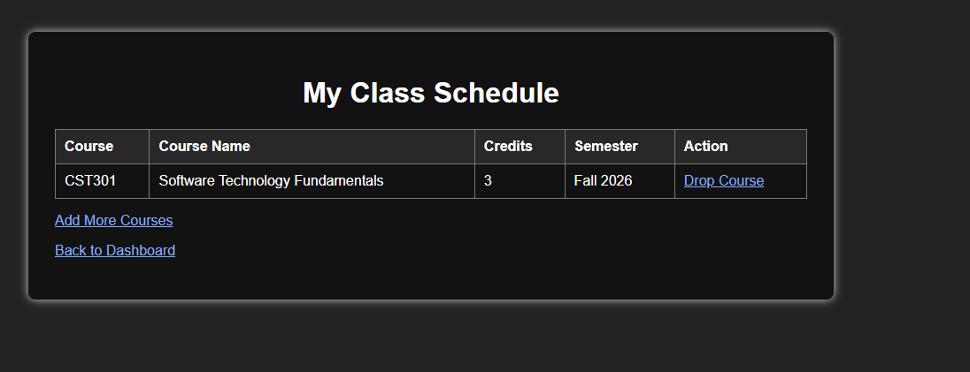
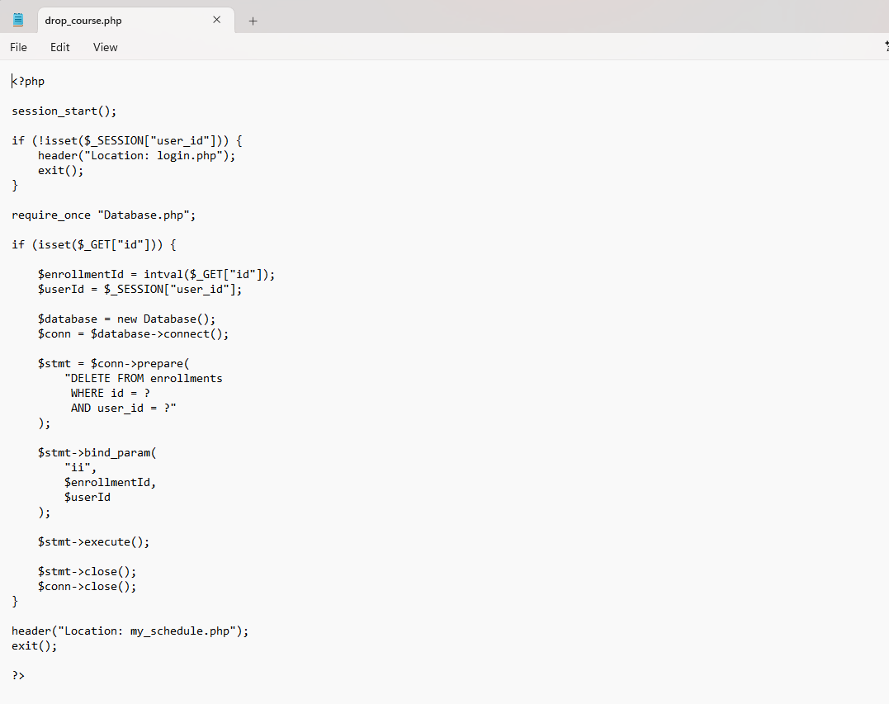
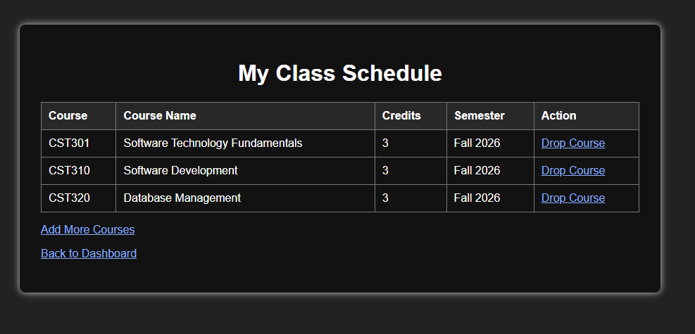
Schedule Management: Add and Drop Courses
The portal can display the current schedule, add more classes, and remove a selected enrollment.
Schedule before adding more courses
Schedule after adding courses
drop_course.php — prepared DELETE statement
INNER JOIN displays course details from the enrollment relationship.
DELETE is limited by both enrollment ID and the logged-in user ID.
Notes:
The my_schedule.php page turns enrollment records into a readable student schedule. Because the enrollments table stores numeric foreign keys, an INNER JOIN is used to retrieve the matching course code, name, credits, and semester. The screenshots show the schedule first with one course and then with three after using the Add More Courses option. Dropping a course is handled by drop_course.php. The PHP code uses a prepared DELETE statement and includes both the enrollment ID and the current user's session ID. That second condition is important because it ensures the student can delete only an enrollment that belongs to the currently authenticated account.

Slide 12
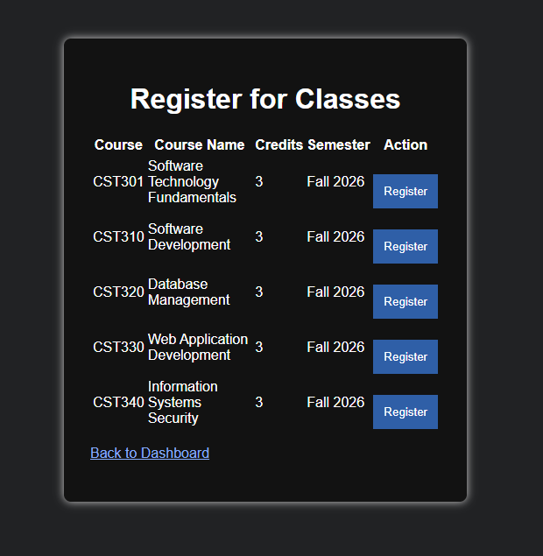
PHP Integration and Final Project Outcome
The completed prototype connects authentication, reusable PHP logic, relational data, and a working student workflow.
Authenticated student dashboard
Available classes / registration interface
Implemented: account creation • login/session handling • course listing • registration • schedule view • add/drop courses • MySQL verification
SRS/UML future extension: full waitlist and seat-notification automation.
(Tsui et al., 2018)
Notes:
The final prototype demonstrates how the major implementation pieces work together. Sessions preserve the authenticated student's identity across pages. The reusable Database class provides the connection needed by registration and schedule functions. Prepared INSERT and DELETE statements change the enrollments table, and phpMyAdmin provides a second way to verify those changes. By the end of Week 4, the working prototype supported account creation, login, course viewing, registration, schedule viewing, adding classes, and dropping classes. The original SRS and UML design also include a full waiting-list and seat-notification process. Those requirements remain part of the documented system design and would be the logical next extension beyond the completed prototype.

Slide 13
References
Scholarly sources and course text used to support the project design and implementation.
Ahmad, T., Iqbal, J., Ashraf, A., Truscan, D., & Porres, I. (2019). Model-based testing using UML activity diagrams: A systematic mapping study. Computer Science Review, 33, 98–112. https://doi.org/10.1016/j.cosrev.2019.07.001
Codd, E. F. (1970). A relational model of data for large shared data banks. Communications of the ACM, 13(6), 377–387. https://doi.org/10.1145/362384.362685
Halfond, W. G. J., Viegas, J., & Orso, A. (2006). A classification of SQL-injection attacks and countermeasures. Proceedings of the IEEE International Symposium on Secure Software Engineering.
Tsui, F. F., Karam, O., & Bernal, B. (2018). Essentials of software engineering (4th ed.). Jones & Bartlett Learning.
Project screenshots and diagrams reproduced from the submitted Week 1–4 course assignments.
Notes:
These are the main scholarly sources and the course textbook that supported the project. Ahmad and colleagues were used in the UML and model-based testing discussion, Codd supports the relational database design, Halfond and colleagues support the SQL-injection discussion, and Tsui, Karam, and Bernal is the course text used throughout the software engineering process. Thank you.

